Slide 1
Process Parameter
Shao-Ku Kao

Slide 2
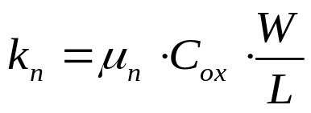
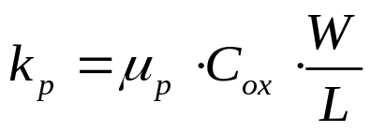
Measurement of Parameter
To achieve maximum possible accuracy, we must determine the parameters appearing in the MOS equations carefully.
The model parameters
  Zero-bias threshold voltage V_{T0 .}
  Channel length modulation coefficient λ .
  Following transconductance parameters:

Slide 3
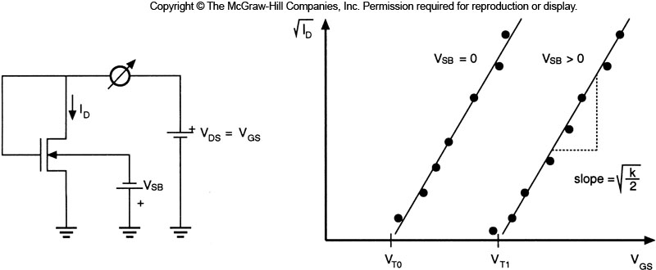
Measurement of Parameter
Drain current measured for different values of the gate-to-source voltage V_{GS}.
MOS operate at Saturation Region

Slide 4
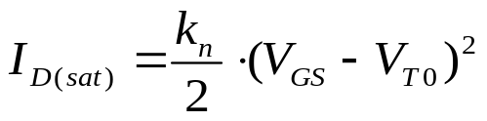
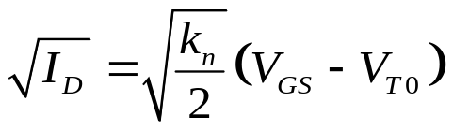
Measurement of Parameter
Neglecting the channel length modulation effect for simplicity, the drain current is described by
Now, the square root of the drain current can be written as a linear function of the gate-to-source voltage.
If the square root of the measured drain current valued is plotted against the V_{GS}, we can find k_{n} , V_{T0}.

Slide 5

Measurement of Parameter
By extrapolating the curves to zero-drain current (voltage-axis intercept point), we can find the threshold voltage V_{T} that correspond the each V_{SB} value.
The slope of each curves is equal to the square root of k_{n}/2.

Slide 6
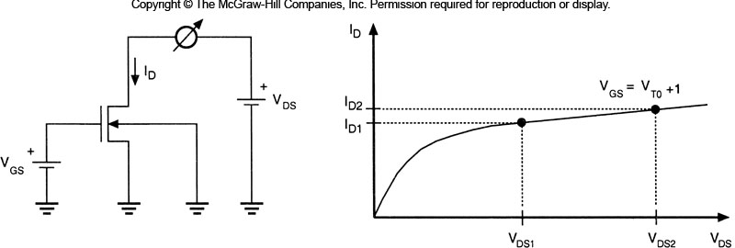
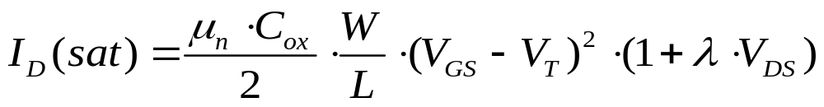
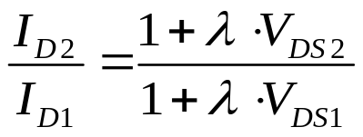
Measurement of Parameter
The drain current in the saturation region is given by
  The ratio of the measured drain current value is
  We can calculate λ from this equation.

Slide 7
Example
Determine the type of the device, and calculate the parameters k_{n}, V_{T0}, and λ.
V_{GS} (V) | V_{DS} (V) | V_{SB} (V) | I_{D} (μA)
0.6 | 0.6 | 0 | 6
0.6 | 1.2 | 0 | 6.4
0.65 | 0.6 | 0 | 12
0.65 | 1.2 | 0.3 | 5
0.9 | 1.2 | 0.3 | 60
1.2 | 1.2 | 0.3 | 199

Slide 8
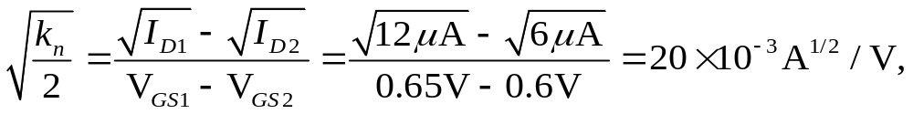
Example - answer
Determine the type of the device, and calculate the parameters k_{n}, V_{T0}, and λ.
Sol.
  Assume that the transistor is diode connected. Using two current-voltage pairs from table with same V_{DS}
  k_{n} :
V_{GS} (V) | V_{DS} (V) | V_{SB} (V) | I_{D} (μA)
0.6 | 0.6 | 0 | 6
0.6 | 1.2 | 0 | 6.4
0.65 | 0.6 | 0 | 12
0.65 | 1.2 | 0.3 | 5
0.9 | 1.2 | 0.3 | 60
1.2 | 1.2 | 0.3 | 199

Slide 9
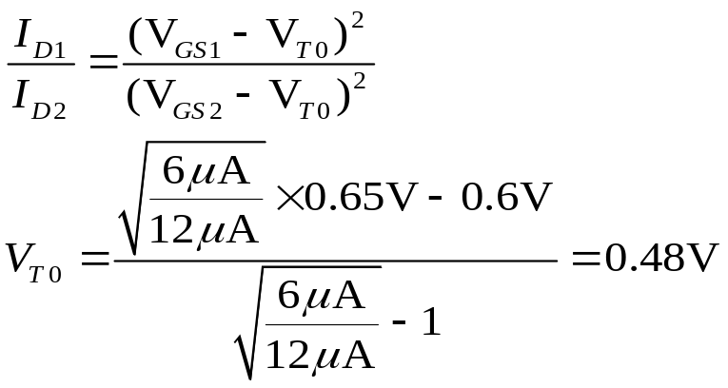
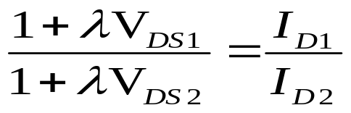
Example- answer
  Using two current-voltage pairs from table with same V_{DS}
  V_{T} :
  Using two current-voltage pairs from table with same V_{GS}
  λ :

Slide 10
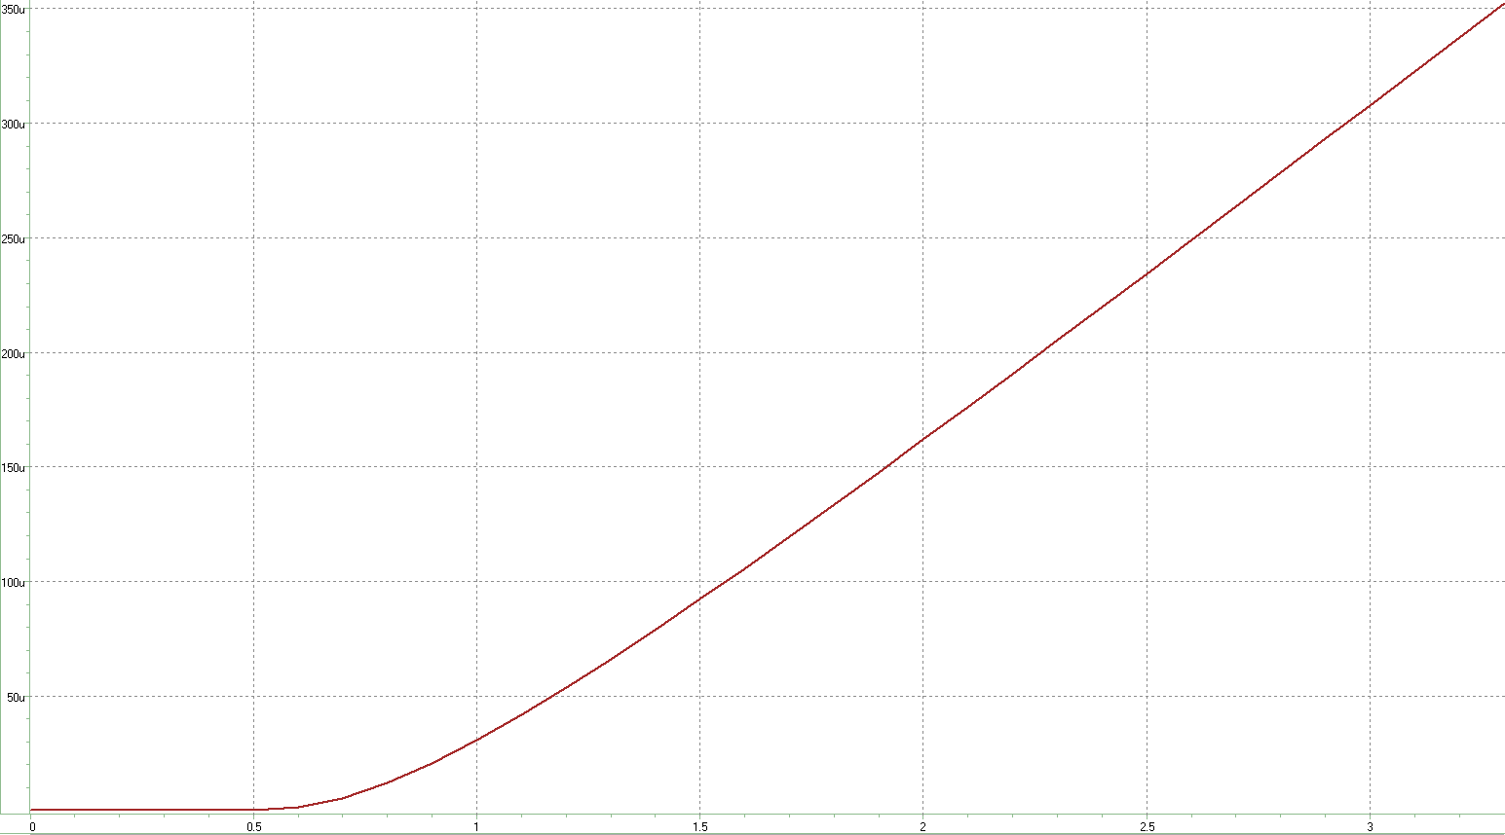
MOS simulation ID vs VGS
MOS
.lib ‘cic018.l' tt
.global VSS VDD
vdd vdd vss 1.8
vss vss 0 0
vd vd vss 1.8
vg vgg vss 0
Vs vs vss 0
.dc vg 0 3.3 0.1
MI11 vd vgg vs vss n_18 L=0.18U W=0.5U
.options post
.probe i1(mi11)
.end

Slide 11
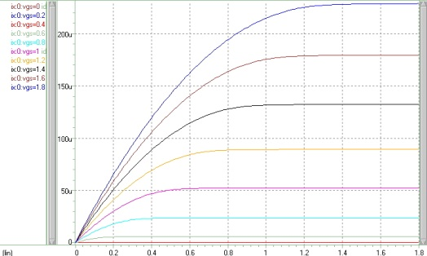
MOS simulation ID vs VDS
id vs vds
.protect
.lib ‘cic018.l' tt
.unprotect
.option post dccap=1
.GLOBAL VSS VDD
vds out 0 1.8v
vgs in 0 gg
.param gg=0
VDD VDD 0 1.8v
VSS VSS 0 0v
MI2 out in VSS VSS N_18 L=20U W=20U
.dc vds 0 1.8v 10mv sweep vgs 0 1.8v 0.2v
.probe ix=I1(mi2)
.end

